Slide 1
Hiring manager – requisition creation in workday (intern/Co-op)
August 2019
University Relations

Slide 2
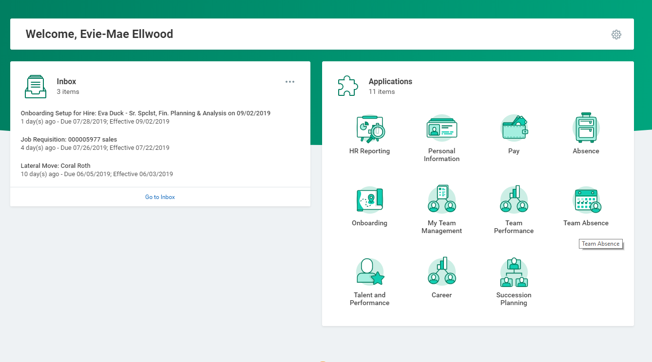

Slide 3
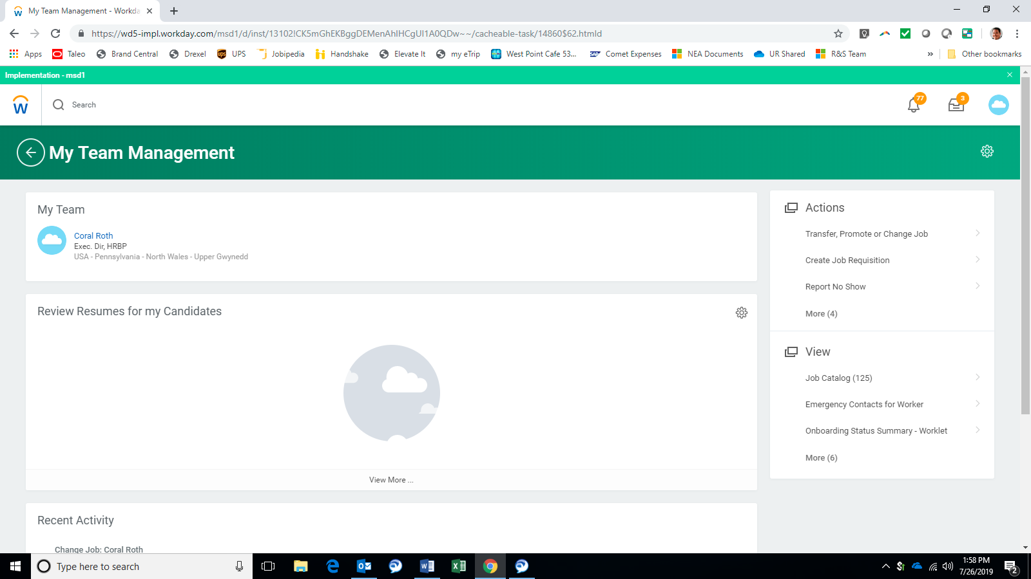

Slide 4
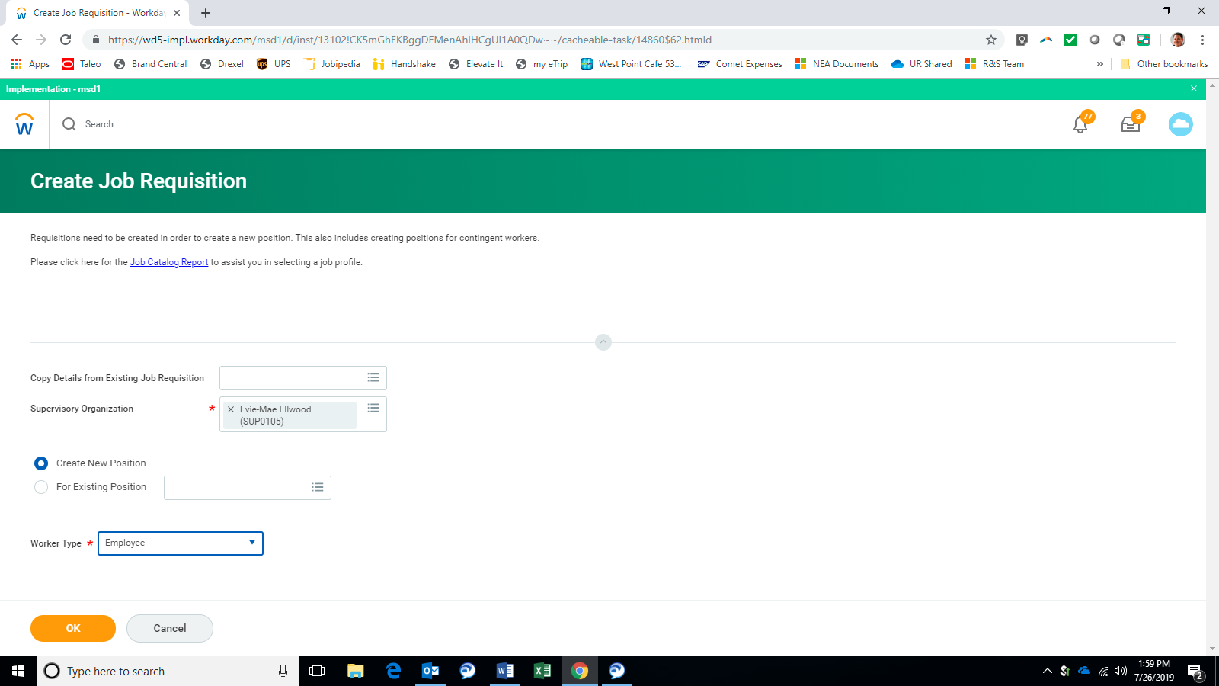

Slide 5
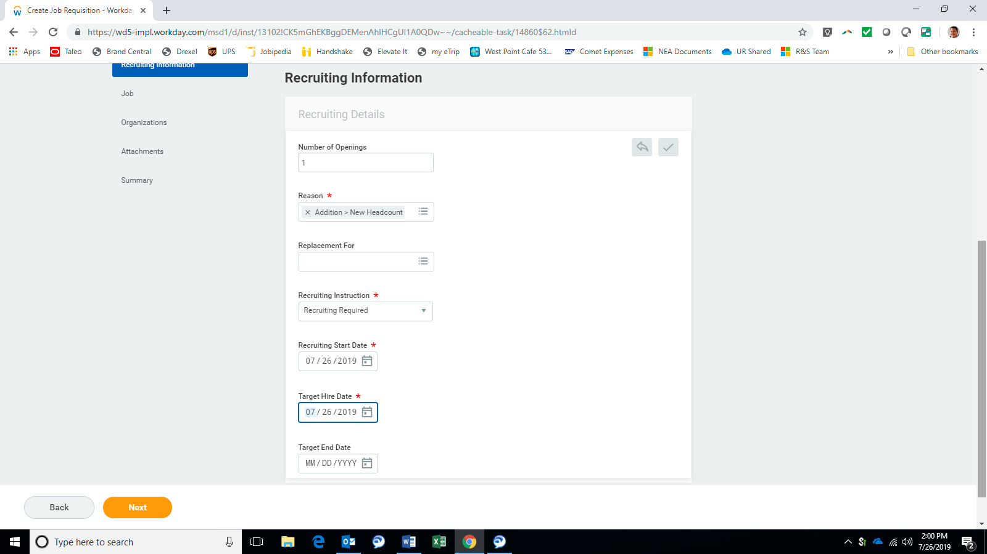
Cannot add positions later – can delete if needed.
Select Addition – New Headcount
Must select Recruiting Required to flow to GTA
Today’s date
Today’s date
Must enter target end date for interns / co-ops

Slide 6
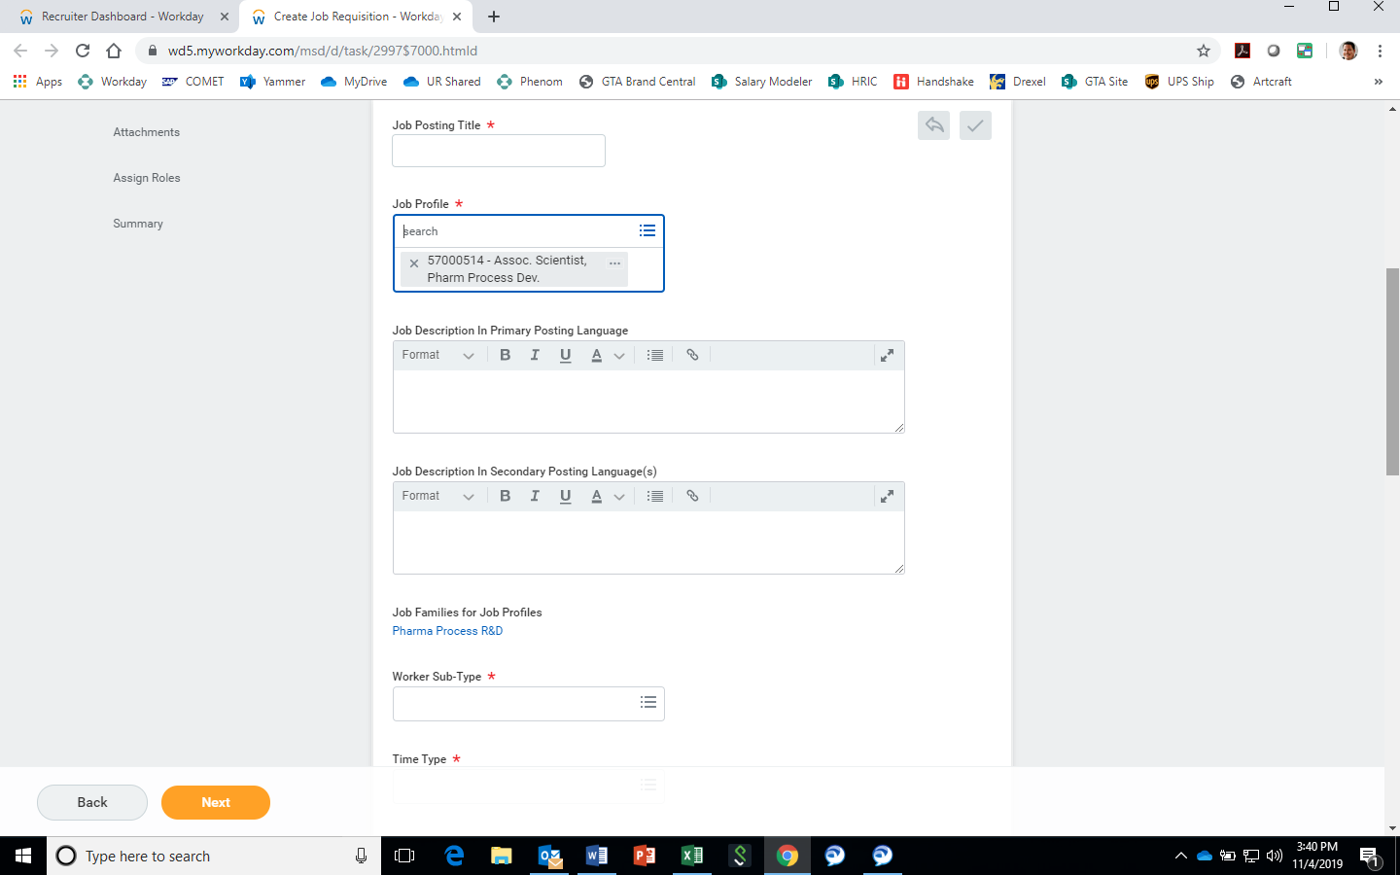
Be sure to include “Intern” or “Co-Op” in the Title
Select Job Profile ID 56990026 “Assoc. Spclst, Administration”. This will align to our intern/co-op profile.
Input job description. **Please include all required and preferred qualifications here.

Slide 7
Reminders about job descriptions
As a reminder the following words / items should NOT be used in any Job Description text GLOBALLY:
“Merck” should be replaced with “our Company” (tradename compliance risk leading to fines)
“MSD” should be replaced with “our Company” (branding compliance governed by global comms)
“MMD” should be replaced with “our Manufacturing Division” (tradename compliance risk leading to fines)
“MRL” should be replaced with “our Research & Development Division” (tradename compliance risk leading to fines)
Product Names (regarded as product promotional by the FDA or ex-US regulatory bodies and will lead to fines)
Molecule Names (regarded as product promotional by the FDA or ex-US regulatory bodies and will lead to fines)
Internal Acronyms should not be used as they would not be understood by external candidates
Email Addresses of our Managers / TAAs (tradename risk, security risk from anti vax / animal rights groups)

Slide 8
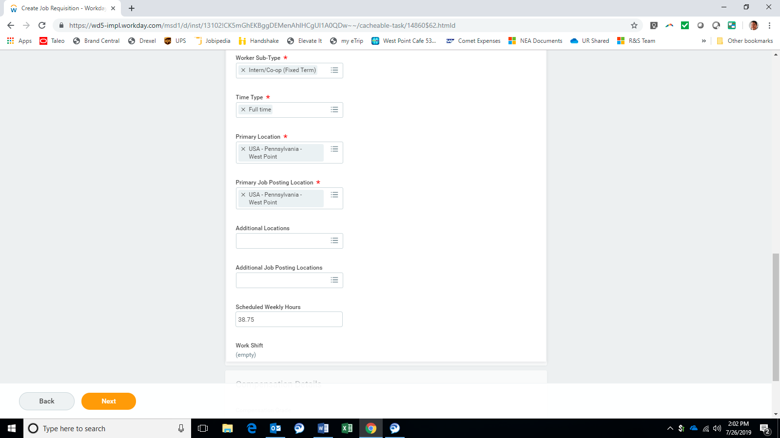
ALL interns / co-ops should be intern / co-op (fixed term)
ALL interns / co-ops should be full-time
Choose primary location
Auto-populated
Add all secondary locations
ALL interns / co-ops should be 38.75 hours

Slide 9
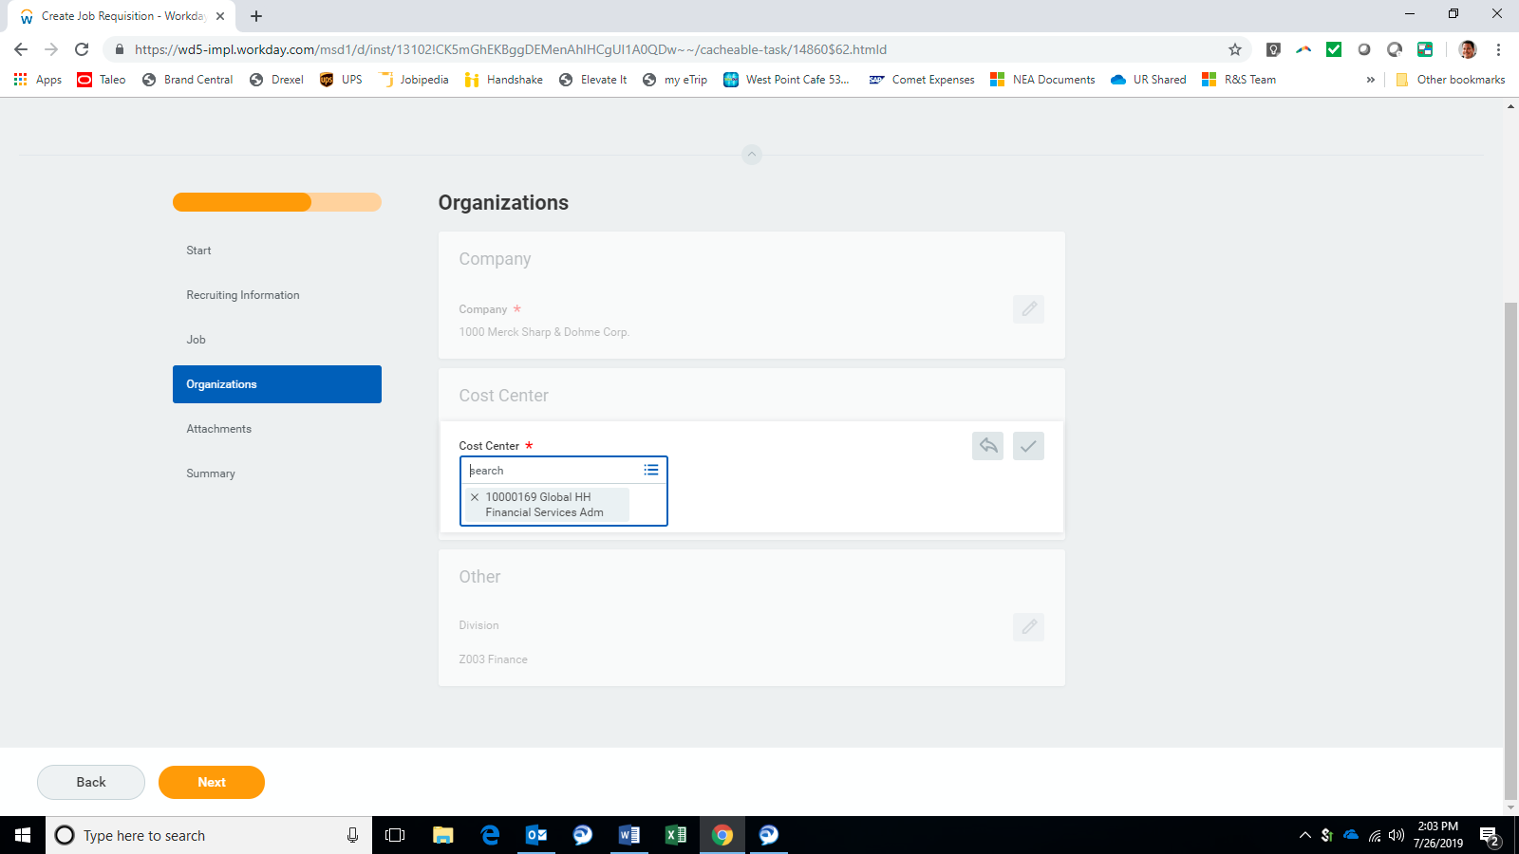
Adjust cost center if needed

Slide 10
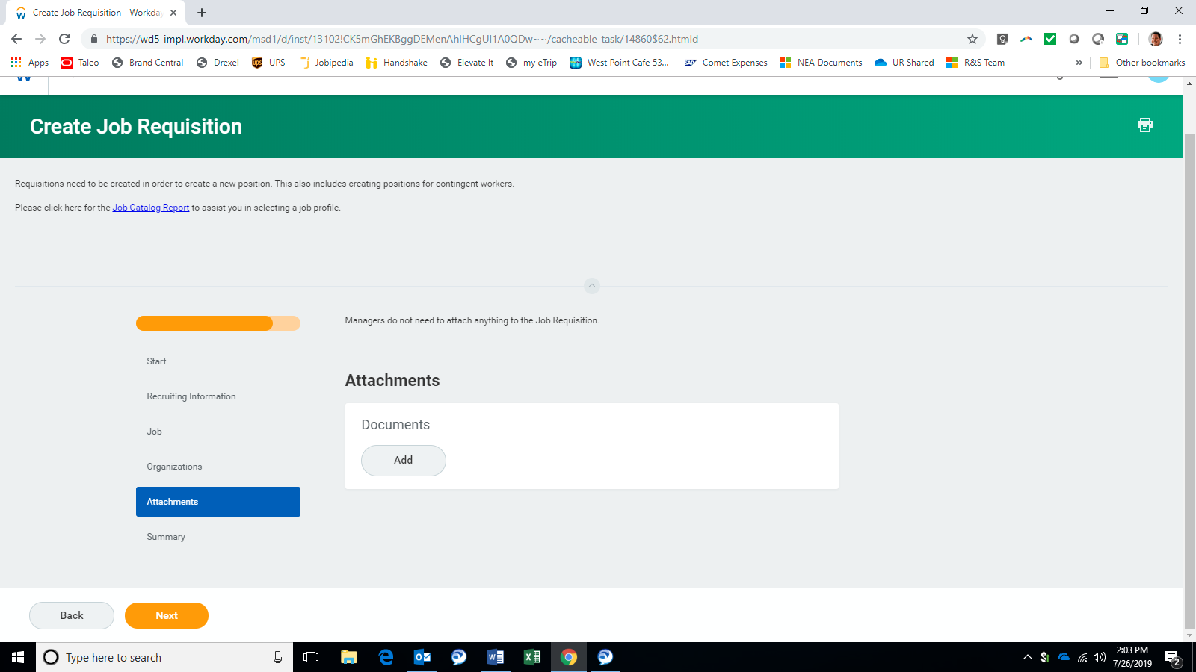
Nothing needed on this screen

Slide 11
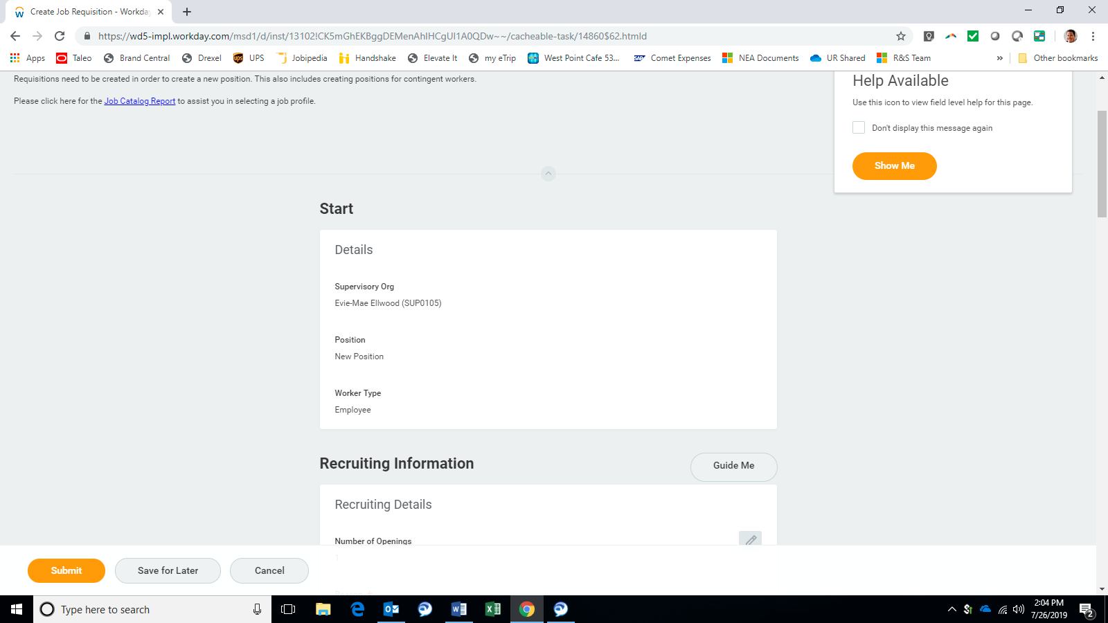
Review and submit!

Slide 12
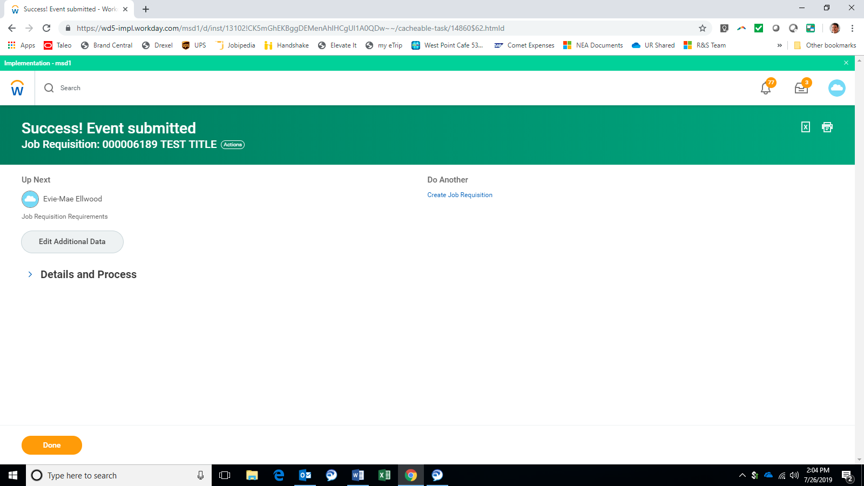
NOT DONE YET!!!!! Must click “Edit Additional Data” to complete the creation process!

Slide 13
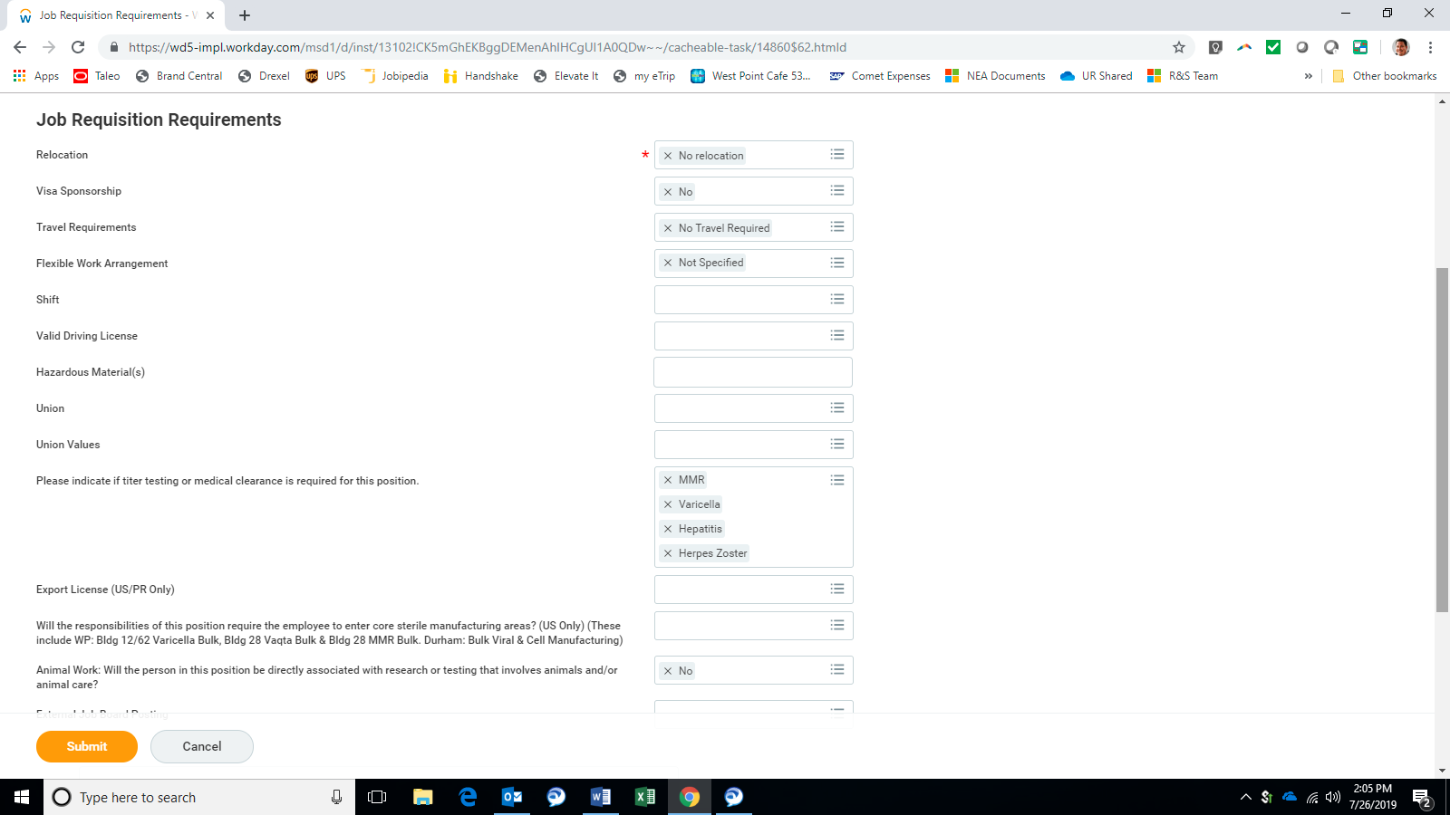
Review and submit!

Slide 14

Success! Off to +1 for final approval.

